Slide 2
National Priorities Industry Linkage Fund (NPILF)
​
UniSQ Industry Projects Information

Slide 3
The Purpose of NPILF
is to support enhanced engagement with providers and industry to produce job-ready graduates. ​
​
Key objectives: ​
increase work-integrated learning across all disciplines ​
increase the number of STEMM-skilled graduates and improve their employment outcomes ​
support Universities in their initiatives to develop partnerships and collaborations with industry
https://www.education.gov.au/job-ready/npilf

Slide 4
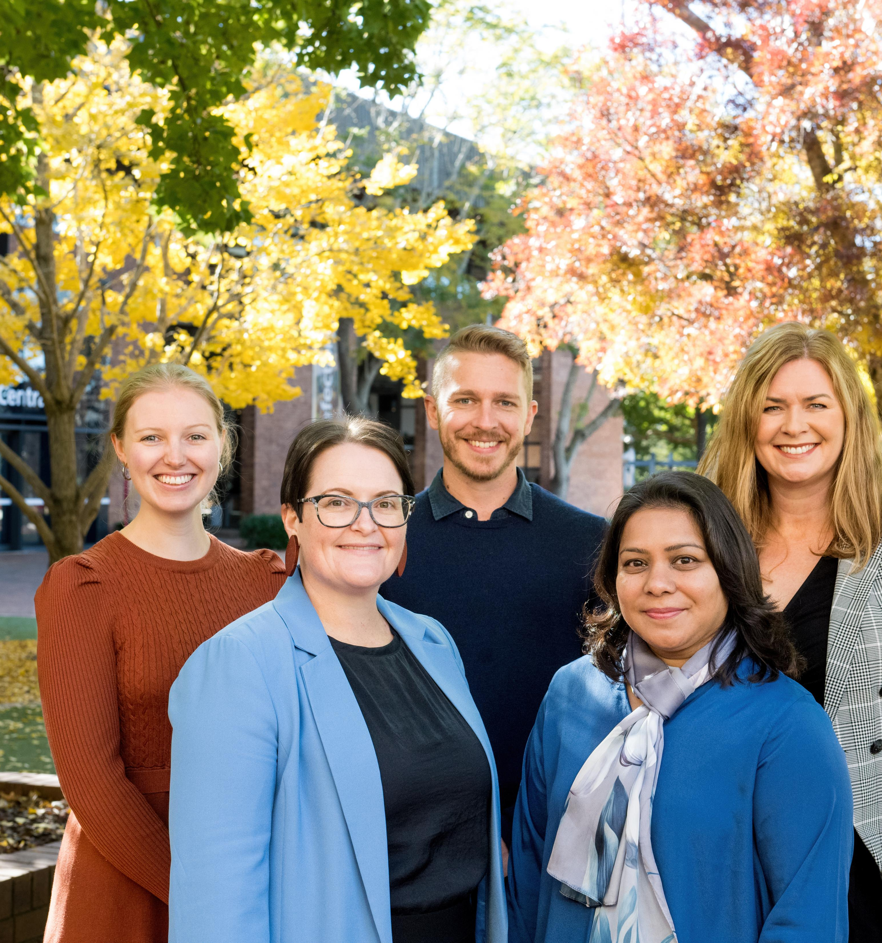
UniSQ Industry Projects Team​
Katie Prenzler, Manager Industry Relationships (NPILF)
Felicity Burns, Project Coordinator, Entrepreneurship (NPILF)
Rachel Hennessy, Industry Relationships Consultant (NPILF)
Dan Stewart, Industry Relationships Consultant (NPILF)
Rozana Azad, Work Integrated Learning Project Officer (NPILF)

Slide 5
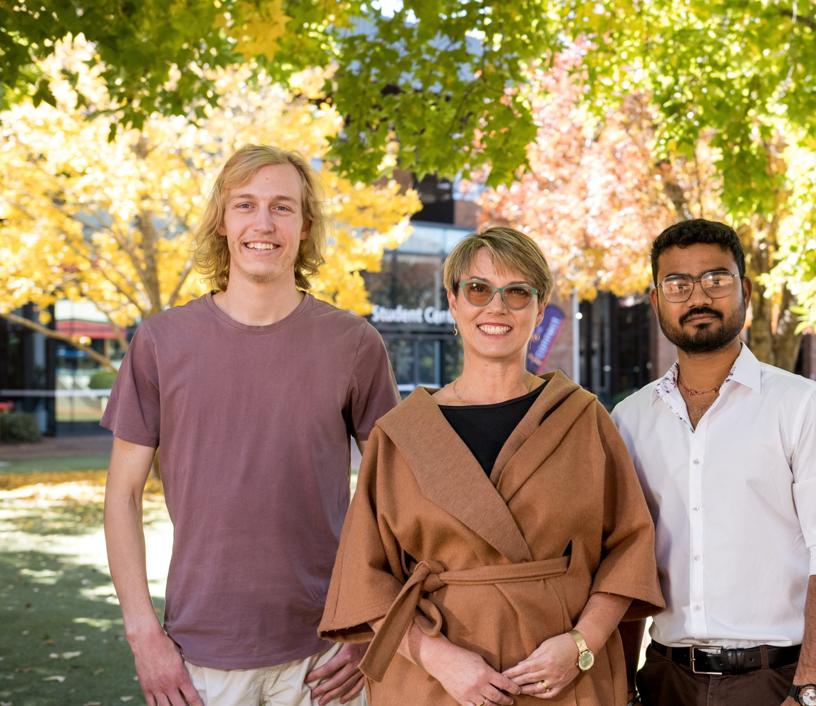
Industry Opportunities
Virtual Work-Integrated Learning (WIL) Projects
Cadetships - connecting regional jobs with students while they study
Workshops - enhancing sessions, modules and resources
Guest Speaking / Site Visits
Mentoring
Events - innovation challenges, networking and showcases

Slide 6
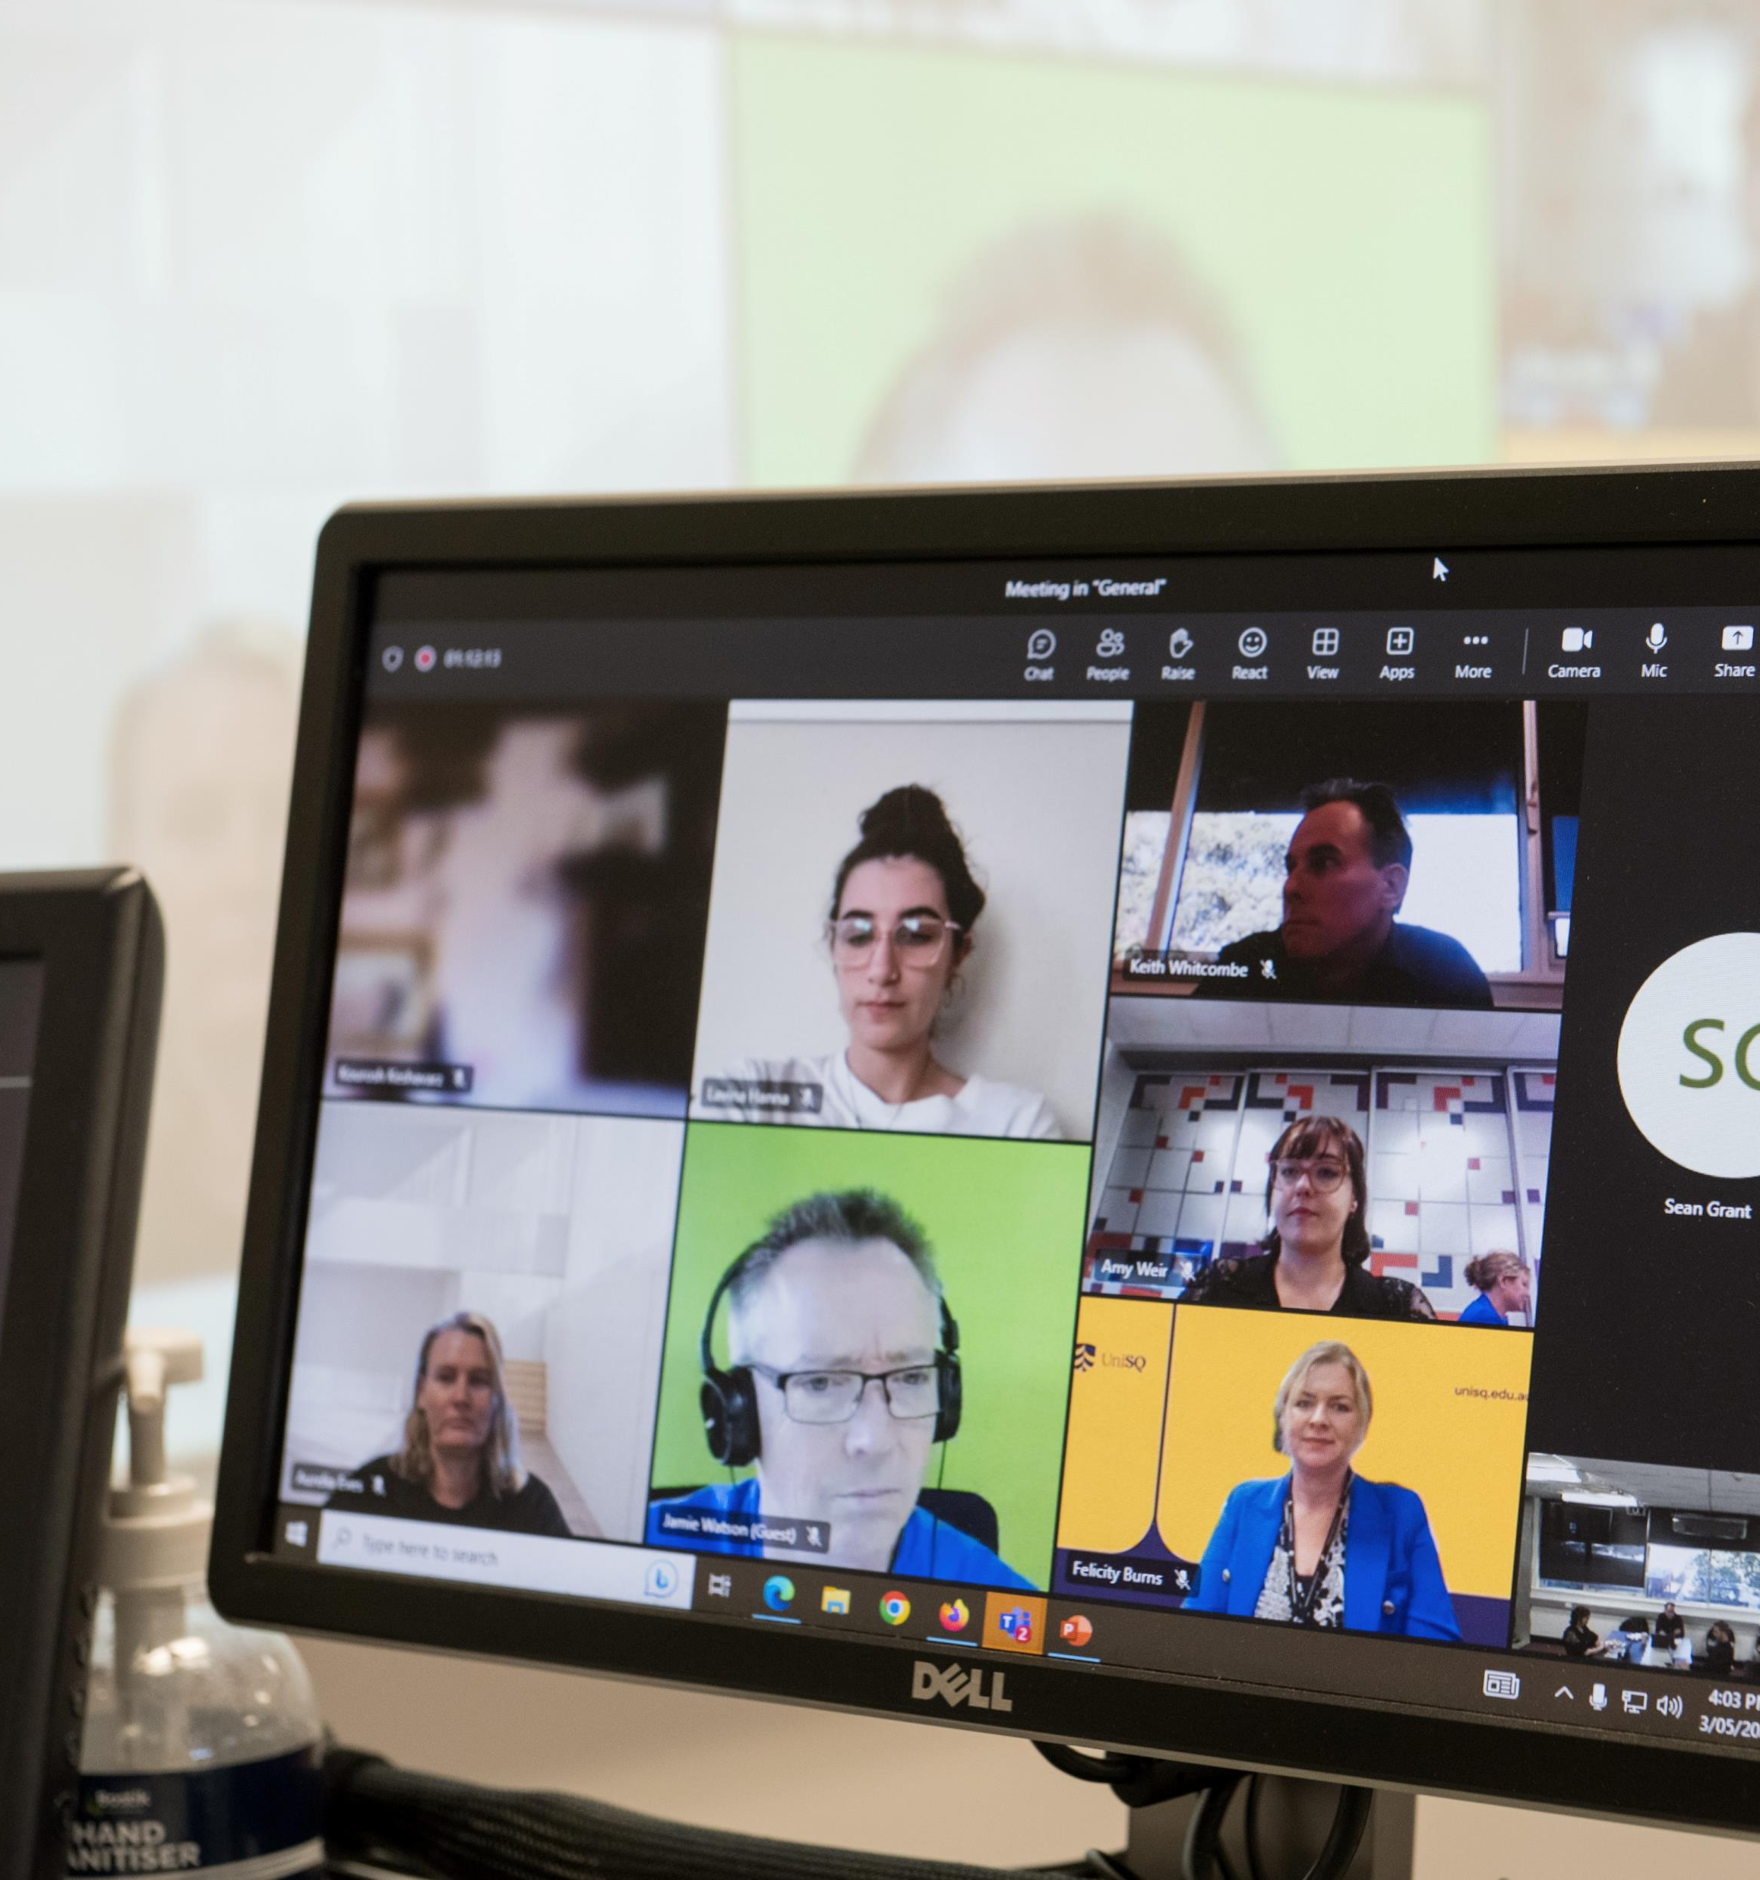
What is a Virtual WIL Project?
The University of Southern Queensland's innovative Virtual Work Integrated Learning (WIL) projects connect students with live, authentic industry experiences, conducted in an online environment.
Notes:
The University of Southern Queensland's innovative Virtual Work Integrated Learning (WIL) projects connect students with live, authentic industry experiences, conducted in an online environment.
Learning is at the center of all projects and by partnering with regional and rural businesses, we are working to enhance the capabilities of you as future graduates and the future workforce, while also delivering mutually beneficial project outcomes.
You will work with a REAL person who owns or works in a REAL business
You will learn about their business challenge or opportunity and work with them to deliver a project outcome
This is a fantastic opportunity and something you will be able to add to your portfolio and resume in the future.

Slide 7
Example Project Briefs
"Our organisation currently lacks a comprehensive cybersecurity policy, leaving us vulnerable to potential cyber threats and data breaches. We need a robust policy in place to protect our sensitive information and ensure compliance with relevant regulations."
"Development of specific outcomes to support the data collection functionality of our existing mobile App."
"Improving web presence and visibility to build my business and customer base.“
"We need a process that enables better conversations with our staff, to ascertain development and support needs so they can be productive and achieve their career goals."
"Our organisation is about to enter a phase of strategic planning; we would like to update our Value Proposition for our customers to ensure they continue to benefit from our services."

Slide 8
Virtual WIL Courses
Course Code | Discipline | Course Name
AGR2209 | Agriculture | Innovation and Entrepreneurship in Agriculture
CIS6001 | Business Technology | Technology Entrepreneurship
CIS6501 | Business Technology | Advanced Information Systems Project
CIS6720 | Business Technology | Cyber Security Project
CSC3600 | ICT | ICT Professional Project
CSC6200 | ICT | Advanced ICT Professional Project
MGT3303 | Business | The Equipped Graduate
CIS5102 | Business Technology | Navigating the Digital Revolution
HAC3001 | Humanities and Communication | The Emerging Professional
CSC6205 | Data Science | Applied Analytics
CIS6025 | Data Science | Big Data Visualisation
ENP4111 | Engineering | Professional Engineer Research Project
SBE4402 | Surveying and Built Environment | Research Project
The Industry Projects Team will help link your project to the appropriate Course.
The Course Specification will show you the Learning Outcomes and Assessment students will undertake as they work through your project.

Slide 9
UniSQ Course Projects
Big Data Visualisation Projects
Showcasing data and statistics
Visualising data and determining trends
Cyber Security Projects
Policy and procedure development
Penetration Testing
Humanities and Communication –
The Emerging Professional
Anthropology, Archaeology, and History
English Literature and Creative Writing
International Relations and Social Justice Entrepreneurship
Information Systems –
ICT Professional Projects
Technology Entrepreneurship
Networking and Cyber Security Major
Software Application Development Specialisation
Network Engineering Specialisation
Data Science or others Specialisation
Engineering –
Final Year Professional Research Projects
All discipline areas
Surveying and the Built Environment - Final Year Professional Research Projects
All discipline areas

Slide 10
Preparing Students and Protecting Industry- The Virtual WIL Acknowledgement
Intellectual Property Rights
Confidential Information
Behaviour
Ethical Values & Code of Conduct
The acknowledgement ensures students understand the significance of undertaking a live industry project.
The acknowledgement has been endorsed by the UniSQ Legal Office and is required for all Virtual WIL Projects.

Slide 11
Virtual WIL Project Management​
Student Team
- Plan project with Industry Partner
- Execute and self-manage all project activities
- Communicate project progress and milestones to Industry Partner
- Provide all end of project deliverables
Course Coordinator
- Structure a course with clear WIL project expectations
- Assess student performance
- Support student success throughout the project
Academic Supervisor
- Provide guidance and support to ensure the student team is on track
- If required, work with Industry Partner to adjust scope throughout the project
- Monitor project progress
- Review deliverables prior to sharing with Industry Partner
Industry Partner / Supervisor
- Provide project goals and objectives
- Provide information and answer questions about company
- Guide student team through the project
- Provide feedback on project progress and output
Industry Projects Team
- Work with Industry Partner to define project scope and briefing for students
- Connect projects with a UniSQ course
- Ensure projects are exciting and support students' learning and development of professional skills
Roles and responsibilities for a Virtual WIL Project

Slide 12
Virtual WIL - Draft Timeline
Timeline | What to Expect | Details
Weeks 1-2 | Student Orientation | Students will receive important information from their Course Coordinator and review the Industry Project Briefs
Weeks 2-3 | First Project Meeting | Student Team's first meeting with Industry Partner for introductions and to discuss project scope
Weeks 2-5 | Students finalise project scope and confirm project plan with Industry Partner | Student Teams meet regularly with the Industry Partner, online via Microsoft Teams Project plan is finalised and agreed upon with the Industry Partner
Weeks 6-13 | Project Implementation and Delivery | Student Teams meet regularly with the Industry Partner, online via Microsoft Teams Regular reporting on project progress is important to seek feedback from the Industry Partner
Mid-Trimester Break | Mid-Trimester Break
Week 7 | Mid-Project Check-in | UniSQ Projects Team will check-in with the Industry Partner to see how the project is progressing
Week 13 | Final Project Deliverables Due | Delivery of project outcomes to Industry Partner in final meeting, online via Microsoft Teams Ask the Industry Partner how they want this delivered, for example, through a presentation or written report
Week 14 | Assessment due and finish course | As per the Course Specification or Study Desk instructions The Industry Partner is not involved in the Course assessment, however, your project deliverables will be a part of the assessment
Notes:
This may vary slightly depending on how your Course Coordinator manages the Course, however, it will give you a good idea of what to expect.
Remember, all Courses at UniSQ are normally a commitment of 10 hours per week. This means that if you do not have class contact time, you should be using these hours to work on the project with your team.
Your Course Coordinator will guide you further on this in the first weeks of your Course.

Slide 13
Testimonials
Hear the benefits for yourself!
You will find 8 video testimonials from both students and industry partners on our dedicated YouTube channel.

Slide 14
Professional Education Partnerships (PEP)
A cadetship-style program for STEMM disciplines that will support regional and rural communities to attract and retain staff, while supporting young people to stay in these communities.
Purpose
Quantify the need for a reliable workforce for industries and future requirements for STEMM graduates.
Develop a flexible/viable program which contracts mutually beneficial commitments.
Impacts:
More students studying STEMM degrees at UniSQ.
More STEMM trained employees who can study while they work and live in regional and rural communities.
Study Areas:
Construction Management
Engineering
Surveying
Agriculture
Animal Science
Urban and Regional Planning
This NPILF project is managed within the Academic Affairs portfolio, by Dr Judy Cawdell-Smith.
Contact: judy.cawdell-smith@unisq.edu.au
https://www.unisq.edu.au/about-unisq/schools-sections/academic-affairs/pep

Slide 15
Industry Presentations
Guest Presentation and Lecture Topics:
Information Technology | Humanities | Engineering | General Topics
Artificial Intelligence Cyber Security Data Science Information Communication and Technology Information Systems Networking Programming Software Development and Application | Anthropology Archaeology History English Literature Creative Writing International Relations Social Justice Entrepreneurship | Agricultural and Environmental Civil Computer Systems and Automation Electrical, Electronic and Power Mechanical and Mechatronic Mining | Your Career Journey Your Organisations Career Opportunities How to apply for jobs in your Industry Thriving during disruptions Changes in the business world

Slide 16
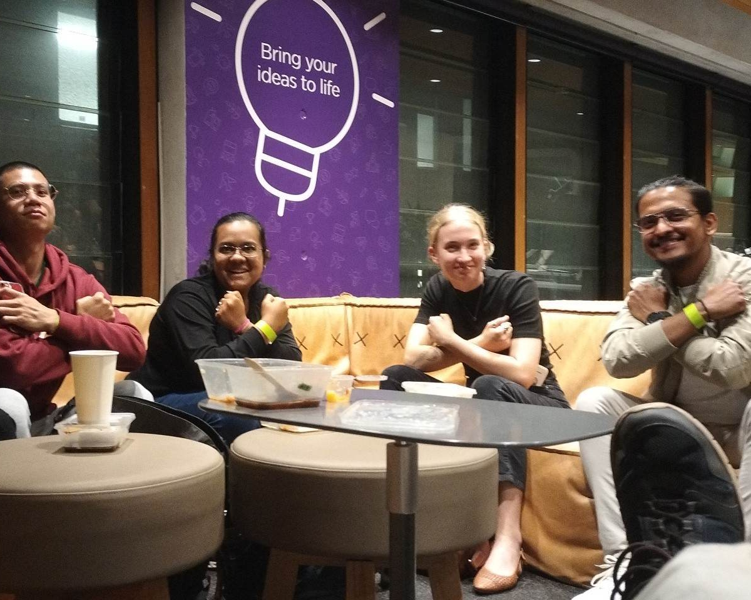
Opportunities for Students
Ignition Accelerator Program
UniSQ’s Ignition Accelerator Program equips students with the resources and industry experiences they need to succeed as innovators and entrepreneurs!
The program is delivered through a series of bespoke workshops delivered by industry experts and is a support hub for UniSQ students with business ideas to launch and scale their enterprises.
Ignition Bursary Fund
Students can apply for up to $1500 to participate in opportunities to gain professional skills and develop their entrepreneurial and innovative mindsets.
Over 119 bursaries have been awarded to date!
Events and Networking Opportunities
The NPILF Industry Projects Team are always looking for opportunities to support students with their professional development, most of which are supported financially through the Ignition Bursary Fund. Share your ideas with us!
https://www.unisq.edu.au/entrepreneurship

Slide 17
Industry Time Commitments
There is no financial cost for organisations to participate in Industry Projects
Time and knowledge sharing are the key contributions necessary from Industry Partners
Project: | Approximate Time Commitment
Virtual Work Integrated Learning Projects | 20 hours per trimester
Industry Research Projects | 8 hours per trimester
Cadetships | We will work with you as needed on the range of opportunities available
Workshops | Up to 8 hours (depending on your role)
Guest Speaking | Up to 3 hours (depending on the forum)
Mentoring | Up to 8 hours (or as agreed with partner)
Innovation Challenges and Showcases | Up to 8 hours (depending on your role)

Slide 18
More information
To learn more about "What's Happening" with the UniSQ Industry Projects Team
Please visit the Industry Projects Team Website
Hear from Industry, Staff and Students on Industry Projects Team YouTube Channel
Speak with our Industry Projects Team to discuss your project ideas and needs: NPILFProject@unisq.edu.au

Slide 19
THANK YOU! We look forward to working with you.

